Slide 1

QUIZIFY
– THE QUIZ APPLICATION
SUBMITTED TO
PRESENTED BY
Mr. Anand Gupta
Technical Trainer
CEA Department
GLA University
Ritesh Dwivedi

Slide 2
Introduction
Quizify is an android application.
The application (quizify) will provide online based quiz with multiple choice question (MCQ)
With this application, users or any organization can perform actions like
Administrative Task
Interview Task
Class Test
Quiz Olympiads etc.
This is a single player feature application.

Slide 3
Technologies used
Microsoft Windows 10
Java Development Kit
Android SDK
XML
Cloud firestore

Slide 4
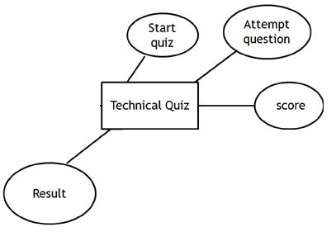
E-R Diagram

Slide 5
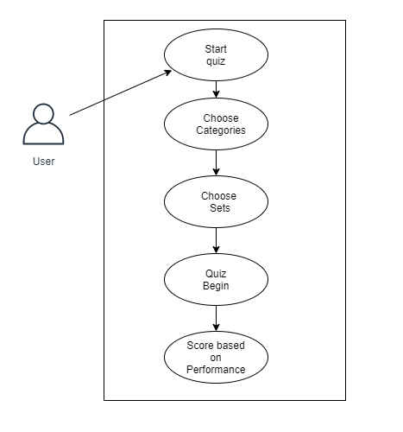
Use Case Diagram

Slide 6
Functional Requirements
Android smart phone based platform.
Provide accessibility to the application through IntelliJ or android phone.
Better Graphical User Interface
Android version should be equal or greater than 4.0

Slide 7
User Interface

Slide 8
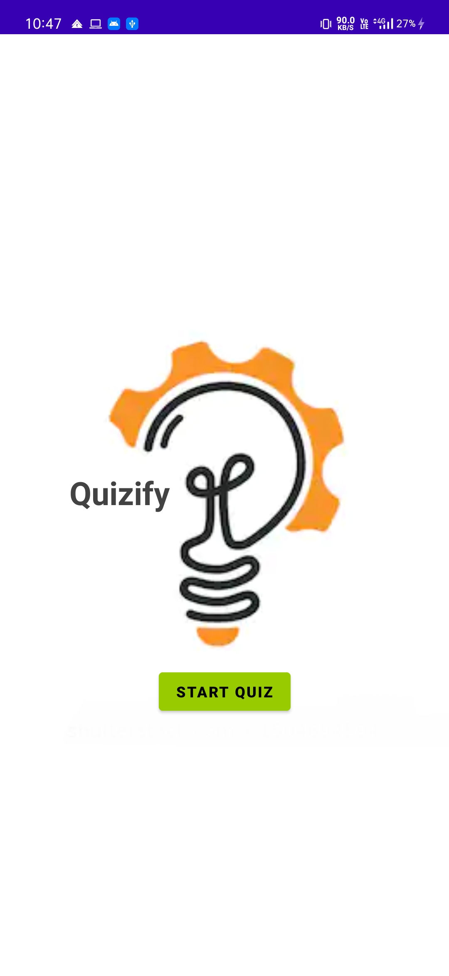
Main Activity

Slide 9
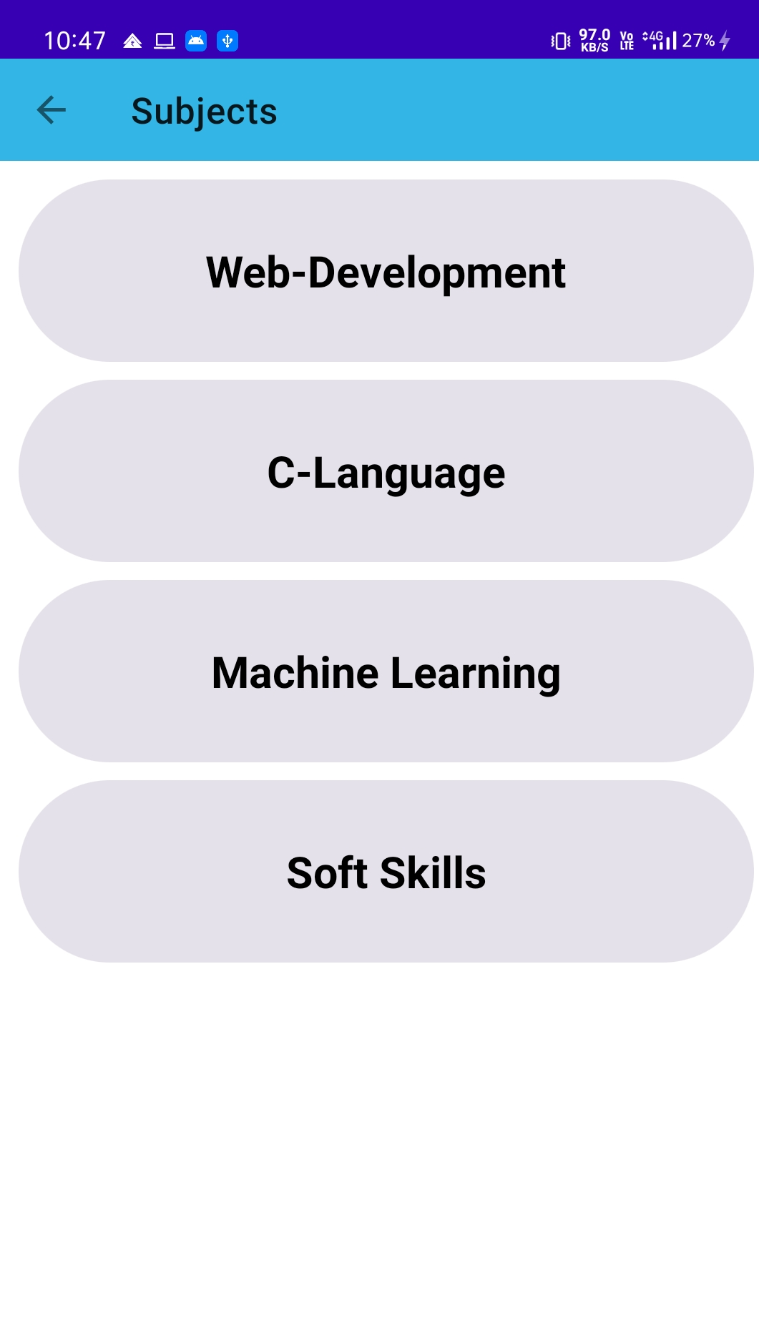
Subject Catogories

Slide 10
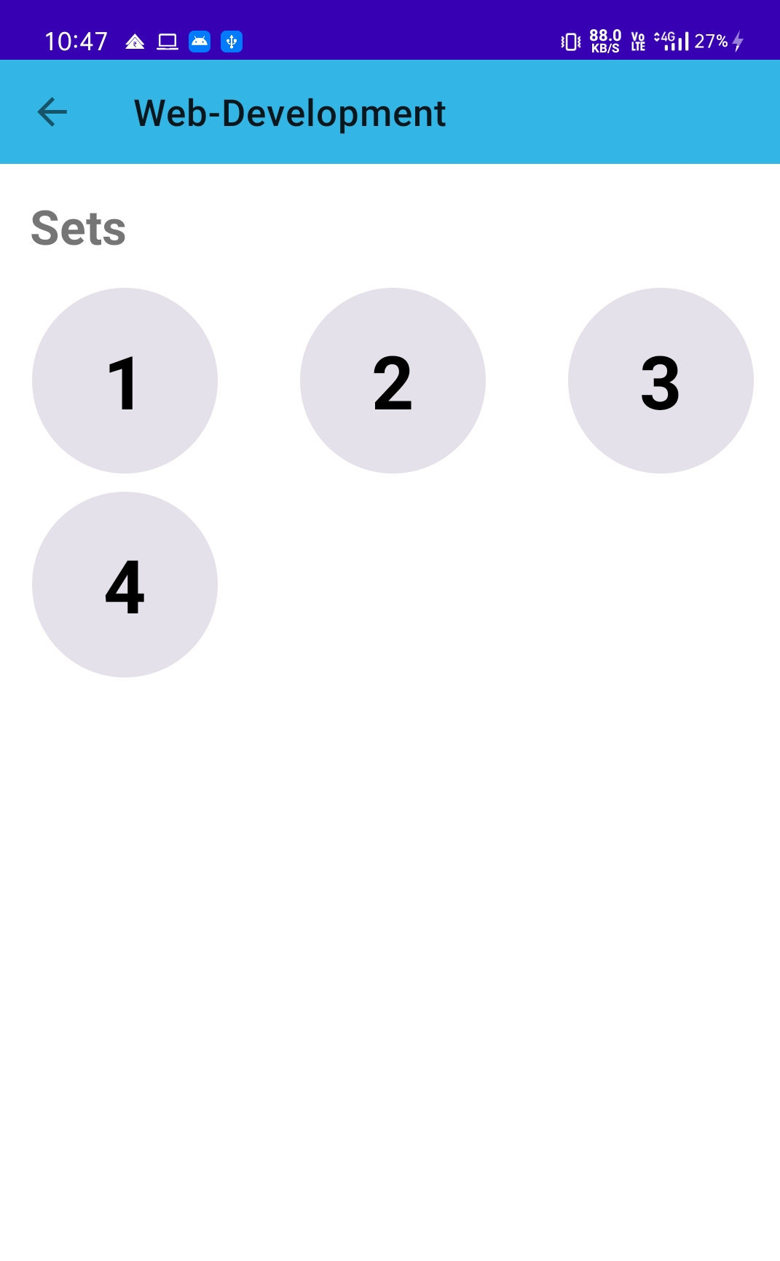
Sets Of Questions

Slide 11
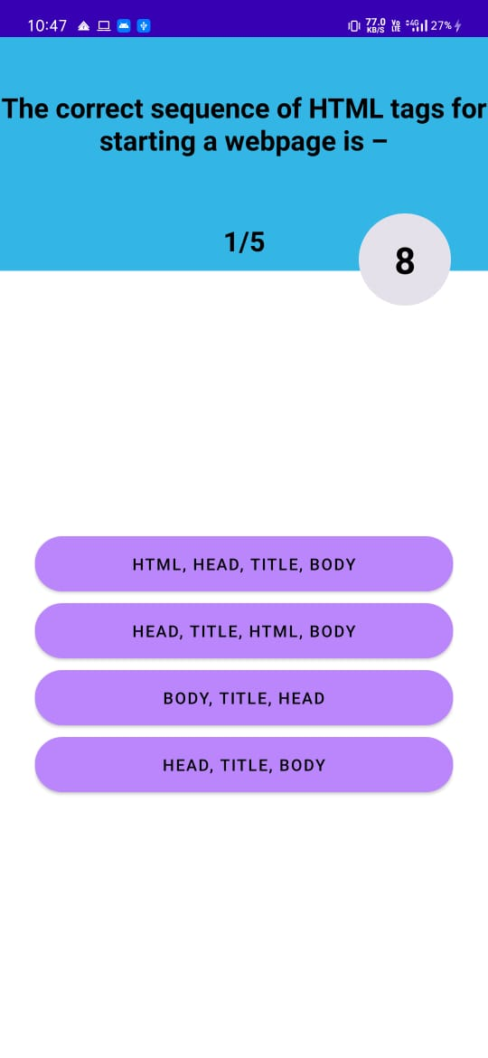
Questios UI

Slide 12
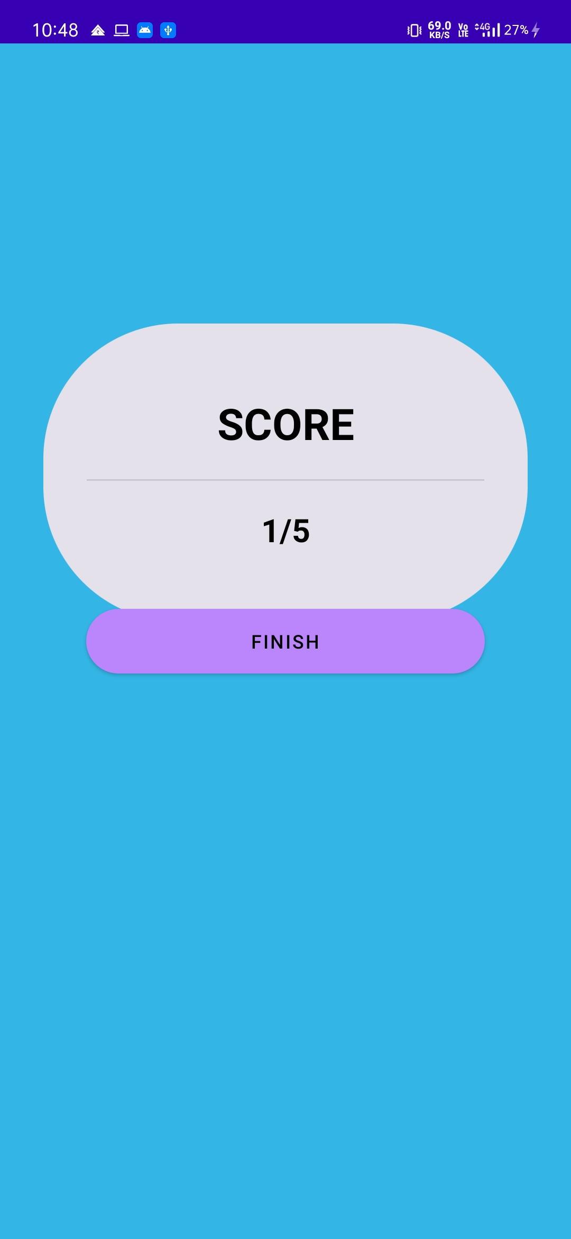
Result Page

Slide 13
Testing
Testing Objectives
To ensure that during operation the system will perform as per specification.
To make sure that the system makes user requirement during operation.
Testing Principles
All tests should be traceable to user requirements.
Tests should be planned long before testing begins.

Slide 14
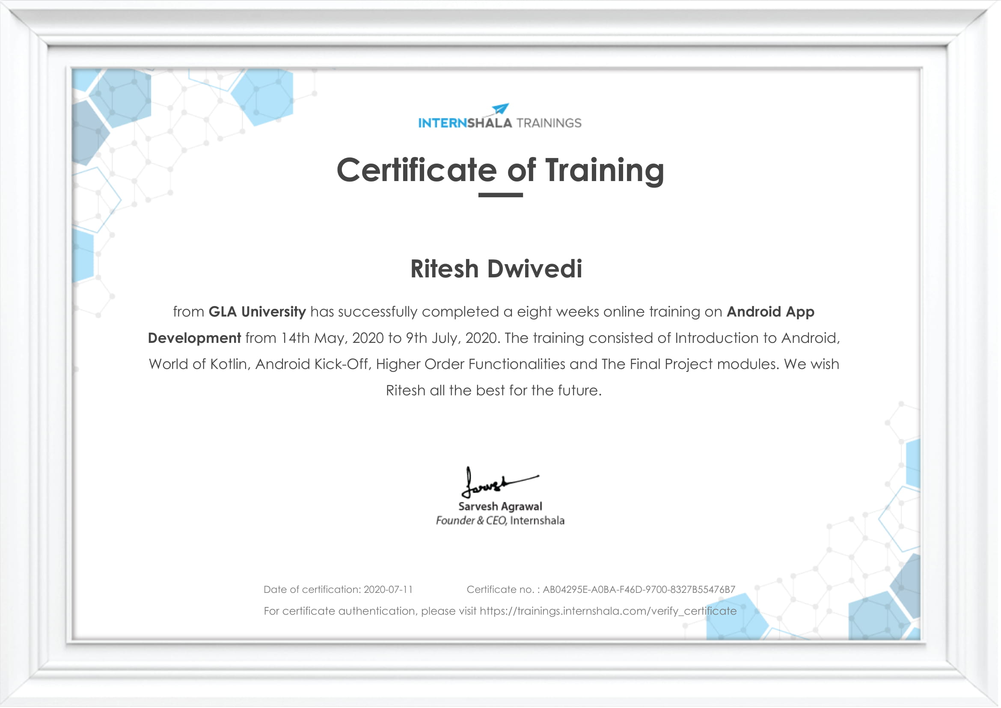

Slide 15
Conclusion
After working on the ‘Quizify’ we would like to conclude that most of the work in this domain (Android) is currently worked upon by the students. But still there are many things which are need ti be addressed as which type of query should be choose as the Application or not . So basically by doing this project we are trying to focus the attention of Computer Science and Information Technology Students in this domain and urges them to work upon this domain as Big companies like Google , Yahoo are hiring people which has appropriate knowledge of Android and has contributed most of the time to this domain.

